Slide 1
Reactive Extensions, LINQ
09 May 18 | Start
Appendix
Online

Slide 2
Reactive Extn, LINQ
Ch | Date
1 | 00 May 18
2
3
4
5
6
7
8
9
10
Programming Reactive Extensions and LINQ 2011

Slide 3
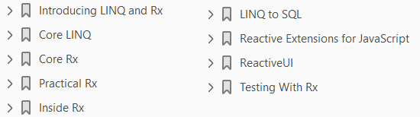

Slide 4
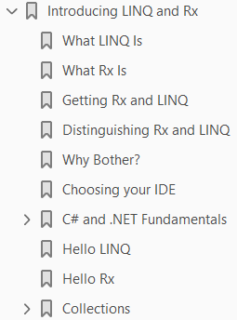
1
Introducing LINQ and Rx

Slide 5
Intro
In a sentence, LINQ is a powerful way to interact with and extract data from collections
while Rx is an extension of LINQ targeted at asynchronous collections
that is, collections that will be populated asynchronously, typically from web services or elsewhere in the cloud.
LINQ was introduced to C# programmers with C# 3.0.
On the other hand, Reactive Extensions (Rx) is an emerging technology, born in Microsoft DevLabs and adopted as part of a standalone full product from Microsoft in 2011.
We believe that the use of LINQ will expand greatly in the next few years, especially in conjunction with Reactive Extensions.
Rx extends many of the principles and features of LINQ to a wide set of platforms (including JavaScript) and will be a vital part of Windows Phone programming, where asynchronous events are the rule.
As the data we deal with becomes more complex, LINQ will help bring order and clarity to .NET programming.
Similarly, as more and more data is retrieved asynchronously from the cloud, and elsewhere, Rx will help you create simpler, cleaner, and more maintainable code.

Slide 6
Agenda
In this chapter you will learn
why LINQ and Rx are important and
you’ll examine some of the fundamental operators of both
LINQ and
Rx
This will provide a context for the coming chapters in which we’ll dive deeper into both
LINQ and
Reactive Extensions

Slide 7
NOTE
Throughout this book we use Rx as shorthand for Reactive Extensions, just as we use LINQ for Language Integrated Query.

Slide 8
What LINQ Is
LINQ (Language Integrated Query)—pronounced “link”—extends .NET to provide a way to query and transform
Collections
relational data, and
XML documents
It provides a SQL-like syntax within C# for querying data, regardless of where that data originates.
LINQ also brings a much more declarative or functional approach to programming than previously available in .NET.
In declarative programming, the logic and requirements are expressed but the execution steps are not.
LINQ and Rx are functional aspects of the C# language, in that they focus more on what you are trying to accomplish than on the steps required to get to that goal.
Most programmers find that the functional approach makes it cleaner and easier to maintain code than the more traditional, imperative style of programming.
With the imperative approach, a program consists of a series of steps—often steps within loops— that detail what to do at any given moment.
In declarative programming, we’re able to express what is required at a higher level of abstraction.

Slide 9
Comparison
It is the difference between saying
on the one hand (imperative): “Open this collection, take each person out, test to see if the person is a manager, if the person is a manager—increase the salary by 20 percent, and put the person back into the collection;”
on the other hand saying (declarative): “Raise the salary of all the managers by 20 percent.”
The imperative style tells you how to accomplish the goal; the declarative style tells you what the goal is.
Using concrete programming examples of Rx and LINQ, this book will demonstrate differences that are more declarative than imperative.

Slide 10
NOTE
Functional programming is one approach to creating declarative code.

Slide 11
What Rx Is
Reactive Extensions provide you with a new way to orchestrate and integrate asynchronous events, such as coordinating multiple streams as they arrive asynchronously from the cloud.
With Rx you can “flatten” these streams into a single method, enormously simplifying your code.
For example, the classic async pattern in .NET is to
initiate each call with a BeginXXX method and
end it with an EndXXX method, also known as the Begin/End pattern
If you make more than a few simultaneous asynchronous calls, following the thread of control becomes impossible very quickly.
But with Rx, the Begin/End pattern is collapsed into a single method, making the code much cleaner and easier to follow.
Reactive Extensions have been described as a library for composing asynchronous and event-based programs using observable collections.

Slide 12
Attributes
Let’s take a closer look at each of these attributes.
Composing: One of the primary goals of Reactive Extensions is to make the work of combining asynchronous operations significantly easier.
To do this, the data flow must be clarified and the code consolidated so that it is less spread out throughout your application.
Asynchronous: While not everything you’ll do in Rx is asynchronous, the async code you write will be simpler, easier to understand, and thus far easier to maintain.
Event-based: Rx can simplify even traditional event-based programs, as you’ll see later in the book when we examine implementation of drag and drop.
Observable collections: The bread and butter of Rx.
An observable collection is a collection whose objects may not be available at the time you first interact with it.
We will return to this topic throughout this book.
For now, the most useful analogy is that
observable collections are to Rx
what enumerable collections are to LINQ

Slide 13
CAUTION
There is significant potential for confusion between the
Silverlight ObservableCollection and
Observable Collections in Rx
The former is a specific generic collection and the latter is any collection that implements IObservable, which will be described in detail later in this book.

Slide 14
Getting Rx and LINQ
If you have .NET 4 or later, you have LINQ—it is built into the framework.
Similarly, if you have the Windows Phone tools installed,
you have Rx for Windows Phone.
To obtain the latest edition of Rx for other .NET platforms, you can go to the Rx site (http://msdn.microsoft.com/en-us/data/gg577610) on MSDN.
There you will find complete instructions for downloading and installing Rx for
Phone
Silverlight
WPF (Windows Presentation Foundation)
Xbox
Zune
JavaScript
You can also install Rx on a project basis in Visual Studio 2010 (and above) using NuGet.
For more information, visit the NuGet project page at http://nuget.codeplex.com.

Slide 15
Distinguishing Rx and LINQ
LINQ is brilliant at working with static collections, allowing you to use a SQL-like syntax to query and manipulate data from disparate sources.
On the other hand, Rx’s forté is in working with what we call future collections—that is collections that have been defined, but not yet fully populated. LINQ requires that all the data be available when we first start writing our LINQ statements. That is, to build a new collection with LINQ, we need a starting collection. What happens, however, if we don’t have all the data? Imagine trying to write a service that operates on live, stock-trading data, in which case we want to operate on incoming streams of data in real-time. LINQ would not know what to do with this, as a stream is not a static collection—its contents will arrive, but they’re not there yet, and the timing of their arrival is not predictable. Rx allows us to operate on this kind of data just as easily as we can operate on static data with LINQ. There is a cognitive boot-strap problem for anyone learning Reactive Extensions, just as there is with LINQ. At first, the Rx code appears confusing and convoluted, and thus difficult to understand and maintain. Once you become comfortable with the syntax and the “mind set,” however, the code will seem simpler than “traditional” programming; and many complex problems devolve to rather simple solutions. The comparison between LINQ and Rx is not coincidental; these are deeply-related technologies. And, you can see the relationship in very practical ways. In LINQ, we take an input collection, and build a pipeline to get a new collection. A pipeline is assembled in stages, and at each stage something is added, removed, or refined—until we end up with a

Slide 16
Why Bother?
After all is said and done, the practical programmer wants to know if the benefits of learning LINQ and Rx are worth the investment of time and effort.
What do these technologies bring to the party that you can’t get elsewhere?
LINQ and Rx are:
First-class members of .NET.
This allows for full support from IntelliSense and syntax highlighting in Visual Studio and LINQPad.
Designed to work with all forms of data, from databases to XML to files.
Highly extensible.
It allows you to create your own libraries in order to extend their functionality.
Composable.
As noted, both LINQ and Rx are used to combine and compose more complex operations out of simpler building blocks.
Declarative. LINQ and Rx bring a bit of functional programming to your code, as described later in this chapter.
Simplifying. Many constructs that take just a line or two of LINQ or Rx would otherwise take many complex lines of confusing code. We’ll take a closer look at Rx and LINQ throughout the rest of the book, but first, you need to get acquainted with the tools you’ll use: Visual Studio and LINQPad.

Slide 17
Choosing your IDE
The examples in this book can be run in any version of Visual Studio 2010 or later, or, with very minor modifications, in LINQPad, a free utility (download at http://linqpad.net) that provides an easy way to quickly try out sets of LINQ statements without the overhead of a complete development environment. Let’s look at a simple example, first using Visual Studio and then LINQPad. To begin, open Visual Studio and create a new Console Application named QueryAgainstListOfIntegers. The complete source code is as follows:
(Page 4).

Slide 18
C# and .NET Fundamentals
Now that you have both tools working, let’s take this small program apart line by line and examine the constructs it uses. In the next section, we’ll review some features of C# and .NET, whose mastery is fundamental to Rx and LINQ.
(Page 6).

Slide 19
Var
Let’s consider the program from the beginning. The first line could have been written as follows:
(Page 6).

Slide 20
Collection Initialization
A second thing to note in this very first line of the program is the use of initialization for the list.
(Page 6).

Slide 21
IEnumerable
Because enumerable is an IEnumerable, you can run a foreach loop over it, as done here. As will be noted many times in this book, IEnumerable is the heart of LINQ, and as we will see, IObservable is the heart of Reactive Extensions. IEnumerable is an interface; classes that implement that interface will provide MoveNext(), Current() and Reset(). Typically you can ignore this implementation detail, as you do when using for each, but understanding how IEnumerable works is critical to seeing the connection between Link and Reactive Extensions. You can, in fact, rewrite the foreach loop using the following operators:
(Page 7).

Slide 22
Properties
Properties have the wonderful characteristic of appearing to be member-fields to the client of the class, allowing the client to write, for example, the following:
(Page 7).

Slide 23
Automatic Properties
In a normal property, there is an explicit getter and setter; however, it is very common to find yourself writing something like the following:
(Page 8).

Slide 24
Object Initialization
Assume that you create a Person class that looks like the following:
(Page 8).

Slide 25
Delegates
Much ink has been spilled attempting to explain delegates, but the concept is really fairly simple. A delegate type is the definition of an object that will “hold” a method. At the time you create a delegate type, you don’t necessarily know exactly which method it will hold, but you do need to know the return type and parameters of that method. A delegate instance is an instance of a delegate type. By creating an instance of the delegate, you can use that instance to invoke the method it “holds.” For example, you might know that you are going to invoke one or another method that determines which shape to draw, but you have a number of such methods. Each of these methods returns a string (with the name of the shape) and each takes an integer (used to decide which shape will be drawn). You would declare the delegate type as follows:
(Page 9).

Slide 26
Anonymous Methods
Anonymous methods allow you to use an inline, unnamed delegate. Thus, the previous program could be rewritten as follows:
(Page 10).

Slide 27
Lambda Expressions
Anonymous methods are made somewhat obsolete by lambda expressions. The previous could be rewritten as follows:
(Page 10).

Slide 28
Hello LINQ
Let’s take a look at another very simple LINQ program in which we extract the even numbers from a list of numbers (which, admittedly, can be done even more easily without LINQ!), as shown in Listing 1-1.
(Page 12).

Slide 29
Hello Rx
The problem with creating your first Rx program is that if it is simple enough to qualify for the job, then it is too simple to do anything more useful than what could be done without it. The following is an example:
(Page 13).

Slide 30
Collections
Both LINQ and Rx work with collections. LINQ works with collections that implement IEnumerable, which we will call enumerable collections. Rx works with collections that implement an extension to IEnumerable, IQueryable, which will refer to as observable collections. The enumerable collection is familiar, as it is the basis for foreach loops in C#. Each enumerable collection is able to provide the Next item in the collection until the collection is exhausted. The details of how this is done will be covered later in the book.
(Page 13).

Slide 31
Enumerable Collections
Every generic collection provides the ability to enumerate the values. This means that each collection allows you to ask for the first element, then the next, and the following and each element in turn until you stop asking or the collection runs out of elements. The underlying mechanism is that these collections implement IEnumerable. The IEnumerable interface is as follows:
(Page 14).

Slide 32
Observable Collections
Rx works with an observable collection, itself based on the Observer design pattern (see the upcoming sidebar). As noted, a Reactive Extensions observable collection is not the same thing as a Silverlight ObservableCollection control, though both are based on the observer design pattern.
(Page 14).

Slide 33
Observable Collections vs. Enumerable Collections
Enumerable collections have all their members present at the moment that you are ready to work with them. You can “pull” each item from the collection when you are ready for it, adding, for example, each in turn to a list box. An observable collection, however, does not have its members available when first created; the members will be added to the collection over time (perhaps by acquiring them from a web service). In this sense, an observable collection is a “future collection.” As the members of the observable collection are added, they are pushed out to the subscribers who have registered with the collection, who may then work with these members as they each become available. In the next section we’ll work through an example that will clarify this discussion.
(Page 15).

Slide 34
Example: Working with Enumerable and Observable Collections
In this example, we’re going to create a pair of ListBoxes for a Windows Phone. We’ll populate one from an enumerable collection and the other from an observable collection.
(Page 15).

Slide 35
2
Core LINQ

Slide 36
Intro
The relationship between LINQ and Reactive Extensions (Rx) is deep and fascinating.
We will explore the relationship between the two in Chapter 5, but for now it is sufficient to point out that
the central element in LINQ is IEnumerable,
much as the central element in Rx is IObservable
Many of the same operators appear in both frameworks, such as Select and SelectMany.
In this chapter we will dive into LINQ in a bit more depth,
first exploring the syntax of a LINQ statement, and
then a number of useful LINQ operators, and
concluding with a demonstration program that will illustrate many of the central concepts of LINQ.

Slide 37
LINQ Syntax
There are a number of flavors of LINQ, each tailored to work with different types of data. LINQ to Objects is designed to work with objects in memory, while LINQ to SQL is designed to work with SQL serverbased data. The essence is the same, however, and LINQ to Objects shows that essence particularly well. Consider the following statements, which you can copy and paste directly into LINQPad:
(Page 19).

Slide 38
IEnumerable
We are able to iterate over the values in query in the previous example (the foreach loop) because the LINQ expression returns an IEnumerable.
In fact, if you hover over the identifier query in either Visual Studio or LINQPad you will see that it is identified to be of type IEnumerable, as shown in Figure 2-1.
(Page 20).

Slide 39
Query Operators
We’re going to look at several LINQ operators later in this chapter, but to get us started, examine Listing 2-1, in which we use the orderby and group by query operators to find all the methods of the int type. Note that LINQ automatically uses reflection as needed, to obtain the methods we’re searching for.
(Page 20).

Slide 40
Deferred Execution
A key aspect of LINQ is that execution of a query statement is deferred until you actually ask for the first item in the sequence. Consider the following code:
(Page 22).

Slide 41
The Good
The following is an example that demonstrates deferred execution by slowing down the requests for evaluation:
(Page 22).

Slide 42
The Bad
Deferred execution can have a downside, as well. In the next example, we set up a LINQ query and then iterate through the results twice. The output may not be quite what we anticipated or want.
(Page 23).

Slide 43
Core Operators
A key aspect of becoming comfortable with LINQ is taking advantage of its myriad of available operators.
We won’t try to provide an exhaustive list, but rather we’ll focus on some of the most useful among them.
(Page 25).

Slide 44
Any
The operator Any returns a Boolean value and can be used to determine if a sequence is empty or whether it contains a particular predicate.
(Page 25).

Slide 45
Contains
A second way to determine if a value is in a list is to use the contains operator. This overloaded operator checks to see if a value is in a list. We can rewrite the second test as follows:
(Page 26).

Slide 46
Take
Take allows you to determine how many objects you’d like to retrieve from what may be a very large collection, as follows:
(Page 27).

Slide 47
Distinct
Often you will have a collection with duplicate values. The Distinct operator removes the duplicates and works only on the unique values, as follows:
(Page 28).

Slide 48
Zip
Zip is a fascinating operator. It is used to thread two lists together. The easiest way to do it is to call Zip on the first list, passing in the name of the second list, and then a lambda statement indicating how you want the lists zipped together. The result of Zip is an Enumerable.
(Page 28).

Slide 49
SelectMany
One of the most powerful operators in LINQ is also one of the most difficult to understand. The principal use of SelectMany is to flatten collections of collections (or hierarchies) into single dimension collections, but as we’ll see in a later section, it has other uses as well. Thus, if we have [1,2,3],[4],[5,6] and we run SelectMany, the result will be a single collection: [1,2,3,4,5,6]. It is critical to come to a complete understanding of SelectMany because the Reactive version is instrumental in helping us chain calls to asynchronous methods. In the following two sections, we’ll take a look, first, at its use to flatten hierarchies, and then to recursively traverse them.
(Page 29).

Slide 50
Flattening Hierarchies
To better understand the use of the SelectMany operator to flatten hierarchies, let’s look at two examples. In our first example, we will create an object, Book, which will contain a list of authors.
(Page 29).

Slide 51
Recursively Traversing Hierarchies
The explanation of SelectMany as flattening a hierarchy is correct, and fine as far as it goes, but it is a slight oversimplification. A more complete way to think about SelectMany is, “for each item in this list, I can replace it with nothing, a single item, or another list.” In the example of flattening, we replace each item in each of the three lists with the same item in the output list. But we can also replace each item with two items, or with a function or with just about anything we like. In the next LINQPad example, we’ll use SelectMany and flattening to manage the hierarchy of folders in a directory, allowing us to recurse over each subdirectory in turn.
(Page 33).

Slide 52
Example: Parsing a Tab Separated File
A real-world challenge, made more tractable by LINQ, is parsing a delimited file and extracting useful information as if it came from a normalized database. In this next example, we parse the contents of a tab-separated, value text file. The following are the first few lines of the file and its tab-separated fields:
(Page 34).

Slide 53
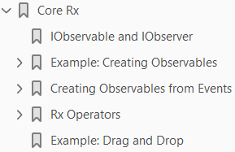
3
Core Rx

Slide 54
Intro
As noted in previous chapters, Reactive Extensions (Rx) is an extension of LINQ.
The key, distinguishing feature of Rx is that rather than being based on IEnumerable, Rx is based on IObservable—that is, the interface for iterating over an observable collection. This, in turn is based on the Observer design pattern as described in Design Patterns.1 The essence of the Observer pattern is that the observable object (sometimes called the subject) has actions or properties of interest to one or more observers. When the observable changes in a way that might be of interest to the observers, it notifies them (typically by raising an event). The nomenclature can be confusing because the Observer pattern is a subset of the Publish and Subscribe pattern, in which a publisher makes information about its state available to one or more subscribers. What truly confounds things is that in Rx, observable collections have subscribers —that is, the objects that observe the observable collection are said to subscribe to the collection. In the case of Rx, an observable collection will notify its subscribers any time an element is added to the collection. This is the essential difference between observable collections and enumerable collections; an observable collection may not have all its members present at the time it is subscribed to; the members arrive and the subscriber is notified.
(Page 40).

Slide 55
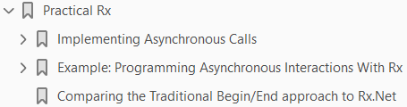
4
Practical Rx

Slide 56
Intro

Slide 57
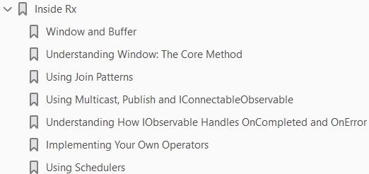
5
Inside Rx

Slide 58
Intro

Slide 59
6

Slide 60
Intro

Slide 61
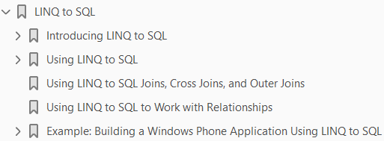
7

Slide 62
Intro

Slide 63
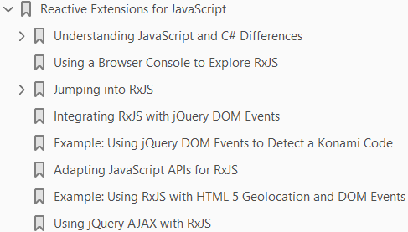
8

Slide 64
Intro

Slide 65
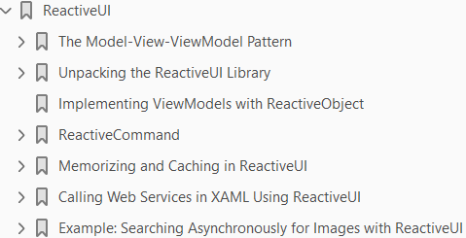
9

Slide 66
Intro

Slide 67
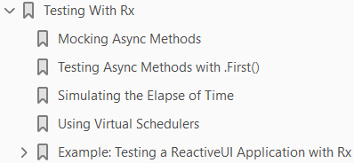
10

